Slide 1
Analysis of Tobacco Use
States with the highest Cigarette, Smokeless Tobacco and E-Cigarette use
Zalak Gajjar

Slide 2
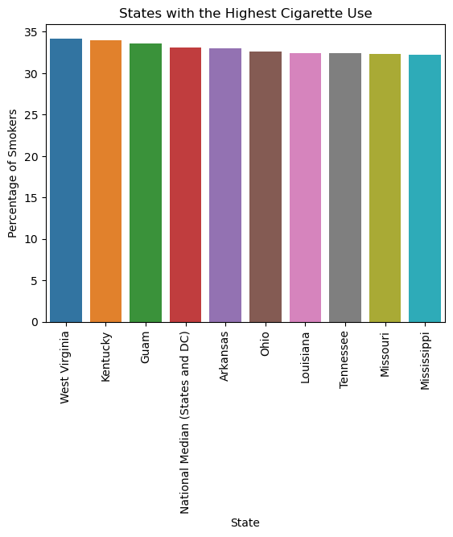
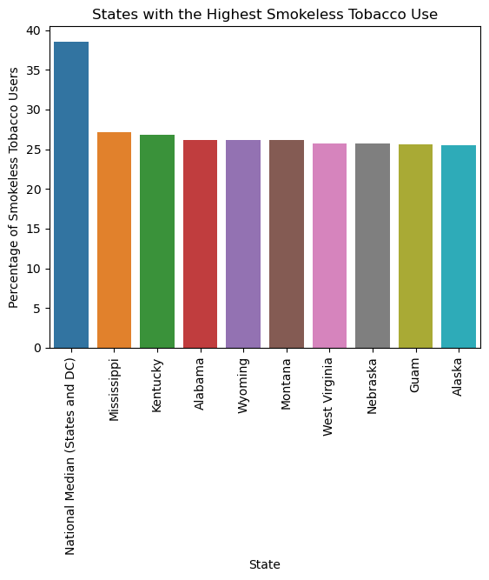
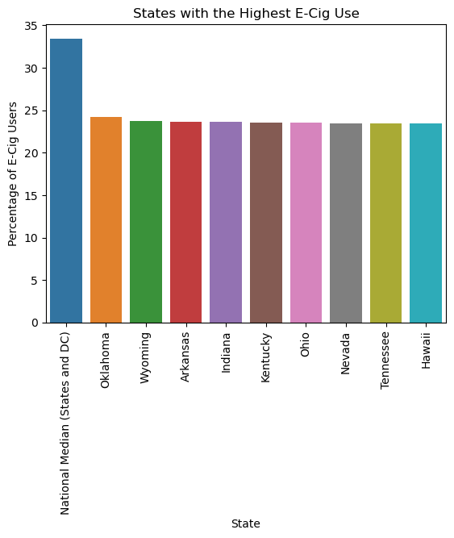
Top 10 States with Cigarette Use
Top 10 States with Smokeless Tobacco Use
Top 10 States with E-Cigarette Use

Slide 3
Conclusion
Cigarette(Adult) is the highest tobacco used among all states.
West Virginia has the highest percentage of cigarette smokers
National Median(States and DC) has the highest percentage of smokeless tobacco users and e-cig users.

